Slide 1



Tkinter
Python GUI FrameWork
Notes:
Hi Guy’s this is going to be very first video on Python Tkinter a gui framework for python. Let’s start the video

Slide 2




What is Tkinter?
Tkinter
Notes:
Tkinter is a Python GUI framework.
It is used to build applications in Linux, Windows and MACOS.
It’s cross-platform, so the same code works on Windows, macOS, and Linux.
Visual elements are rendered using native operating system elements, so applications built with Tkinter look like they belong on the platform where they’re run.

Slide 3

How GUI is Build in Python using tk
Python
Operating System
Hardware
Notes:
computer system consists of hardware now this hardware is controlled by an operating system.
So you write your programs in Python to control the hardware.
Python will do so with thehelp of the operating system

Slide 4
Python
Tool Command Language
Tcl/Tk
Tool Kit
Operating System
Hardware
Notes:
if you wish to build the graphical user interface using Python then just having the operating system and the hardware isn't sufficient Python requires other services and these other services can come from a number of sources but one that of interest to many python programmers is something referred to as tcl/tk
TC l stands for tool commandlanguage it's a scripting language withits own interpreter and TK is a toolkitfor building graphical user interfaces
the thing about tcl/tk is it's notPython so you cannot control and accessthe services of tcl/tk using Python

Slide 5
Python
Tkinter
Tcl/Tk
Operating System
Hardware
Notes:
another package is introduced and thispackage is referred to as TK inter andwhat it acts as is an intermediarybetween Python and tcl/tk in other wordsTK inter allows you to use the servicesof tcl/tk but using the syntax of Python
so as a Python programmer you need notbe directly concerned with tcl/tk yourview of the graphical user interfaceapplications built with Python isgoverned by TK inter TK inter makeseverything appear as an object so youcan create your graphical userinterfaces

Slide 6
Structure of Tkinter Program
from tkinter import *
Import Tk Modules
Create Main Window
Adding Widgets to App
Main event loop
Notes:
We have Tkinter Module which we import in our Script.
First we create a main window
Then we add labels,entrybox,combox to it
And then we run it using a main event loop.
So this is how Tkinter application is built.

Slide 7
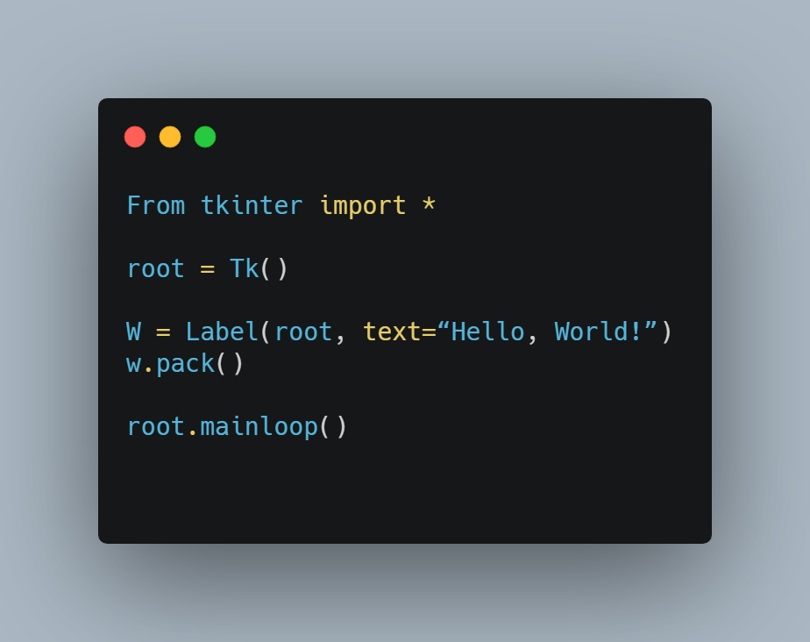
Example :
Simple Tk Program
Import Tk Modules
Create Main Window
Adding Widgets to App
Main event loop

Slide 8
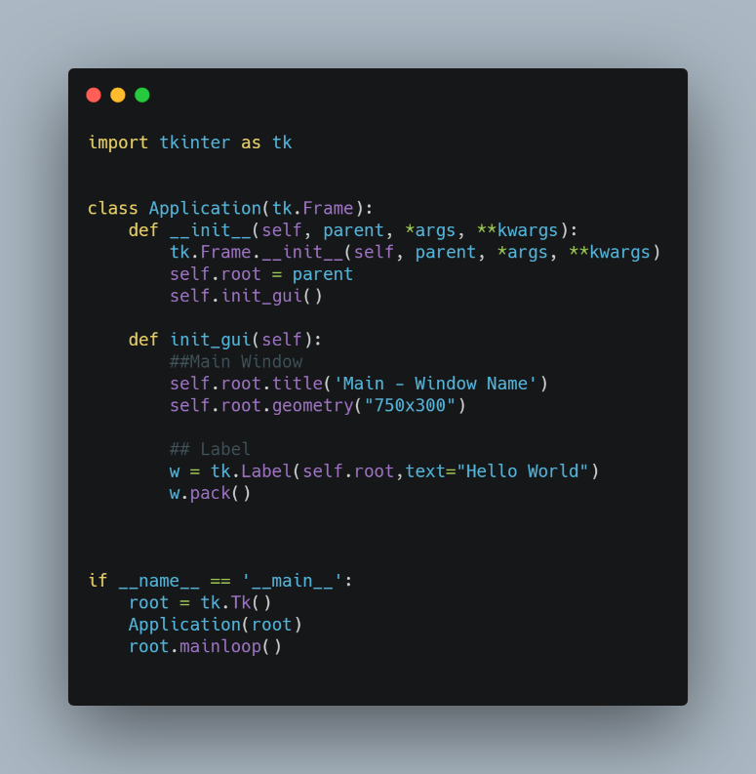
Example :
Tk Program Using Class
Import Tk Modules
Create Main Window
Adding Widgets to App
Main event loop

Slide 9
Basic Tkinter Widgets
Labels
Buttons
Combo box
Entry
Radio Buttons
and many more ……
Notes:
Use to display text or image.
Button is normal like

Slide 10
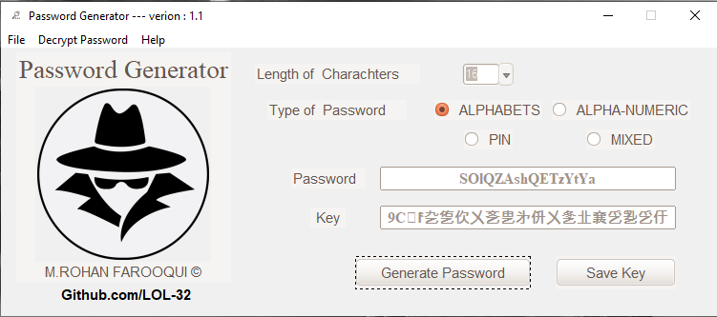
Example
Label - Text
Label - Image
Combo box
Radio Button
Entry
Button

Slide 11

The END
National University of Computer & Emerging Sciences

Slide 12

Advantages & Disadvantages:
Small Projects
Large Projects
Easy to learn
Custom Design App
Cross Platform
No Designer Tool
Notes:
Each has their own strengths and weaknesses
If you want to learn gui from scratch then I recommend this lib
You have to code every thing manually..

Slide 13
Pros & Cons
PROs
Cons
It comes with Python Interpreter.
Best for small projects.
Outdated library.
Manually code.
Notes:
Each has their own strengths and weaknesses
If you want to learn gui from scratch then I recommend this lib
You have to code every thing manually..

Slide 14
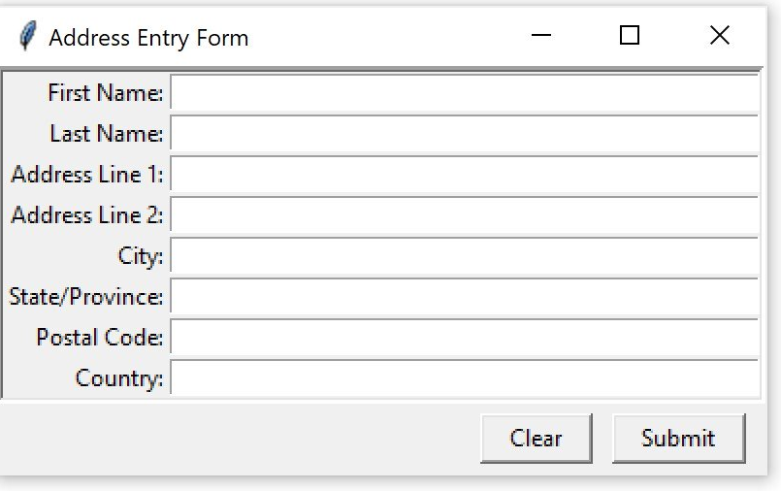
Tkinter OVerview

Slide 15
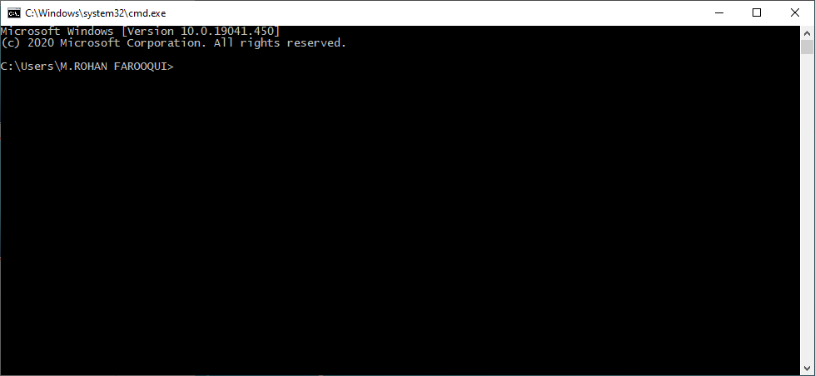
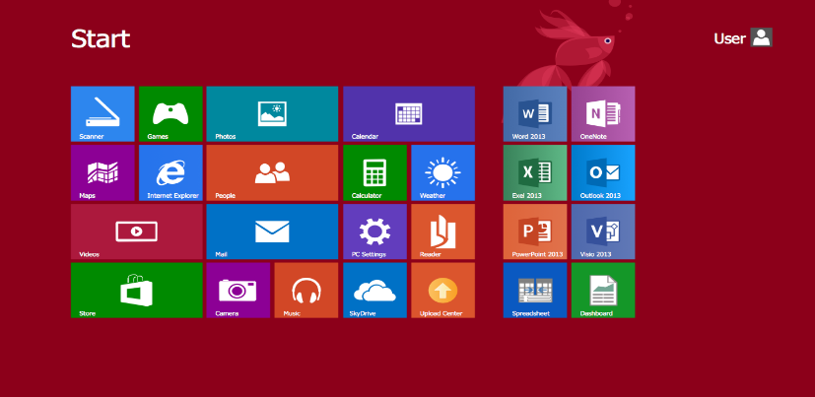
CLI vs GUI
Notes:
So there are two types of interface i.e Command line Interface and Graphical User Interfacae

Slide 16
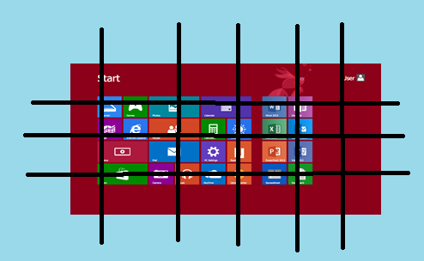
GUI
Label
ROWS
Columns
Notes:
So there are rows and column in which you set labels, entry boxes like all gui things.

Slide 17
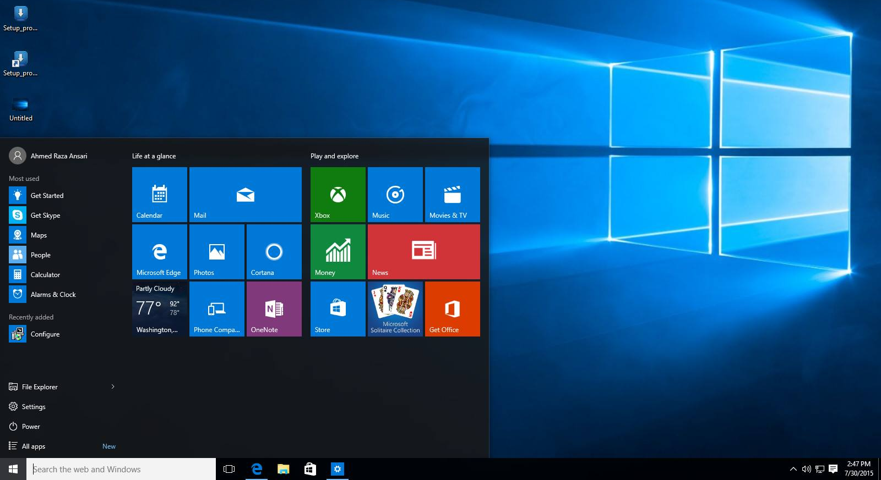

Graphical User Interface
Icons
Pointer
Background
Start Menu
Start Button
Taskbar

Slide 18
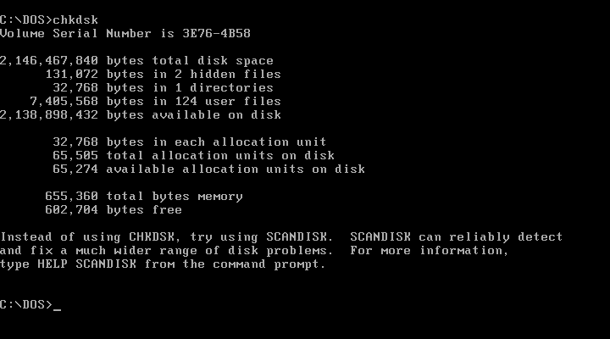
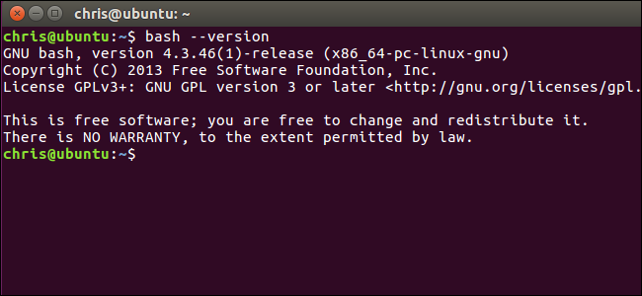
What is CLI?
CLI
Dos – Shell
Bash Shell

Slide 19
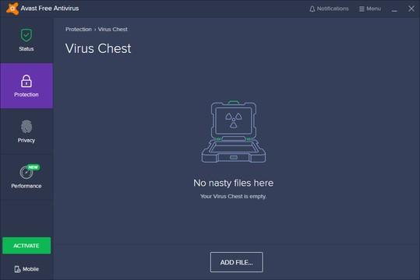

What is GUI?
GUI
Applications
Games

